Slide 1
PaaS the Database, Please
Getting started with Azure SQL DB

Slide 2
Agenda
Intro to Azure SQL DB
Performance Levels
Azure SQL DB specific features
Automated Administration
Gotcha’s
Additional PaaS DB services

Slide 3
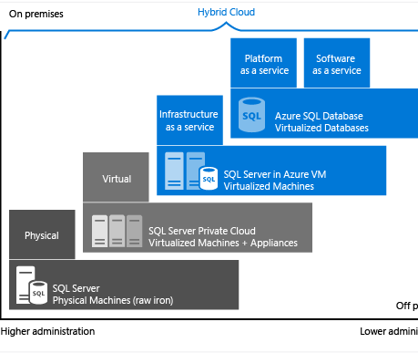
Azure SQL DB
On demand database service
Pay for performance/storage
Easily scale up/down based on need
Easily != Fast
Reduces the burden of administration teams
Server/Storage administration free!
Demo: Let’s spin up some databases!
Notes:
Demo:
Open azure portal
Create a SQL Server Service
Create a SQL DB

Slide 4
Something’s missing
Feature | Replace with
SQL Agent | Elastic Jobs, or Azure Automation
SQL Server Analysis Services | Azure Analysis Services
SQL Server Integration Services | Azure Data Factory v2
SQL Server Reporting Services | PowerBI
Service Broker | DIY
MDS/DQS | You probably weren’t using this anyway
Full-Text Search | Azure Search
Change Data Capture | Try Change Tracking?

Slide 5
Performance Levels
Multiple ways to configure the service
Measured in Database Transaction Units (DTU)
Mix of CPU/RAM/IO
DTU’s range from 5 to 4,000
Basic, Standard, Premium Tiers
Some features are only available in tiers S3+ and Premium
Tier | Included Storage | Max Storage
Basic | 2GB | 2GB
Standard | 250GB | 250GB (1TB on S3+)
Premium | 500GB | 1TB (4TB on P11+)

Slide 6
Performance Levels - Pooling
Elastic Pooling
Databases share DTUs – elastic DTU (eDTU)
Fixed cost, not charged per database
A single pool can contain 50-500 databases depending on tier
Database sharding and multi-tenant solution
Tables are split across multiple databases
Elastic Query can be used to stich partitions together
Additional Purchase option: vCore

Slide 7
Scaling the Database
Easily scale between database levels
Can be done with PowerShell
Not a fast operation
Data is copied to new instance (takes longer the more data you have)
All connections are killed on cutover
DB is available while new instance is setup
DB’s cannot be ‘Paused’ like other services
Demo: Let’s scale some databases
Notes:
Demo:
Scale a database
Run a query (infinite loop or something) to show it killing the connection

Slide 8
Azure SQL DB Features
Elastic Query
Allows for ‘cross-database’ queries on Azure SQL DB
Performance is semi-okay-ish
Elastic Jobs
Allows for automated jobs to run across many databases
Expensive
Demo: Elastic Query

Slide 9
Auto Admin
Backups
Geo-Replication
Automatic Tuning
Advanced Threat Detection
Auditing
Alerts
Demo: Showcase in Portal

Slide 10
Gotcha’s
USE syntax is not available
Scaling will kill all connections
No cross database joins, must use elastic query
No SQL Agent, run things in Azure Automation

Slide 11
Additional PaaS DB Services
Azure Database for MySQL
Azure Database for PostgreSQL
Azure Cosmos DB
Azure SQL DW
Distributed database (MPP)
Azure SQL DB Managed Instance
Azure Storage
Blob Storage
Table Storage
Azure Data Lake Storage
Redis Cache
Azure Analysis Services

